Slide 1
Crossword Generator
Made by Vakulinskiy Olexandr
Academic Advisor: Grebenovich J. E.

Slide 2
Goal and tasks
Goal: creating crossword genrator program
Tasks
Investigate Backtracking algorithm
Create functions for making, saving and reading a grid model
Create function for reading wordlist
Make design of program

Slide 3
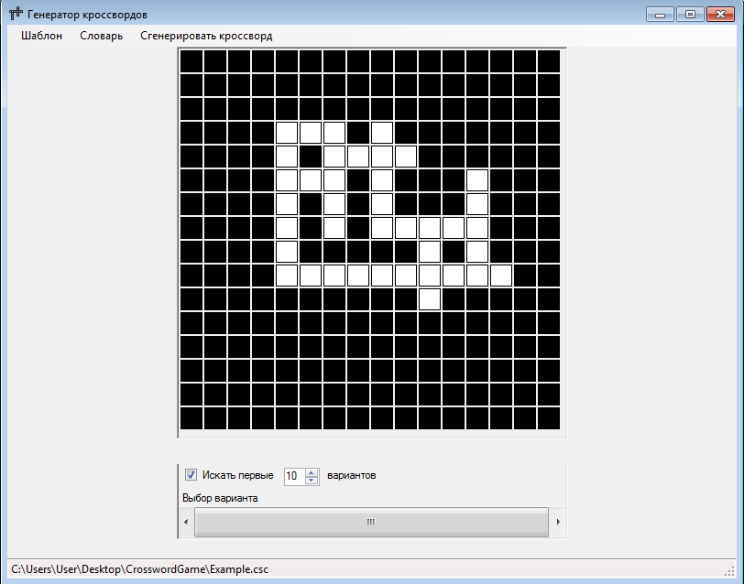
CRISS cross
I've decided to use criss cross puzzle, not classical crossword, becase questions which we use in classical crossword are not important for my program. My goal it's correctly filled grid so, I can use already made wordlist. So criss cross is the best choice for such program

Slide 4
Generating method
Step1
Making a dictionary with sections
Step 2
Sorting words
Compare amount of horizontal and vertical words
Step 3
Generate

Slide 5
Backtracking
Start
Reject
Reject
Reject
Reject
Complete
Backtracking is a general algorithm for finding all (or some) solutions to some computational problems, that incrementally builds candidates to the solutions, and abandons each partial candidate (“backtracks”) as soon as it determines that the candidate cannot possibly be completed to a valid solution.

Slide 6
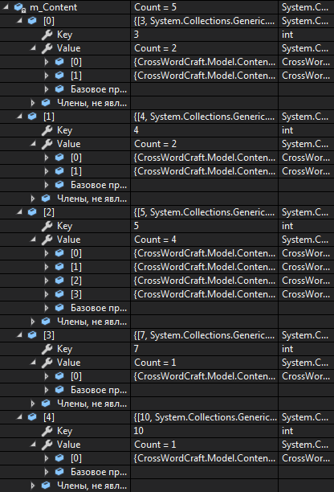
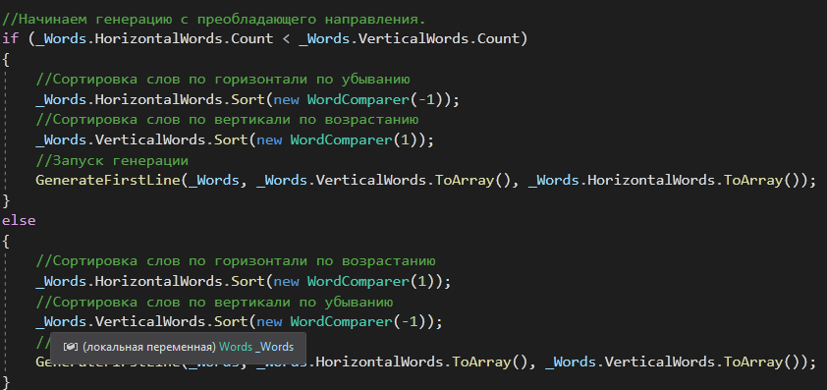
Algorithm optimization
First optimization
Dictionary optimization
Second optimization
Heuristic method
Branch and bound
Third optimization

Slide 7
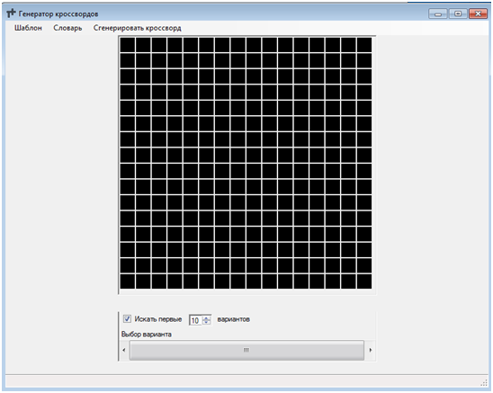
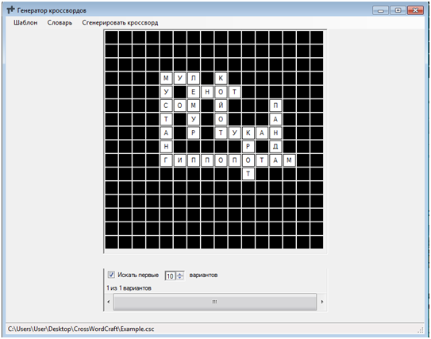
Results
So we have a program, which can solve any criss cross puzzle. User is able to create different grid models and save it. Also if you have more difficult puzzle, program can find couple of variants and show it to you

